Slide 1
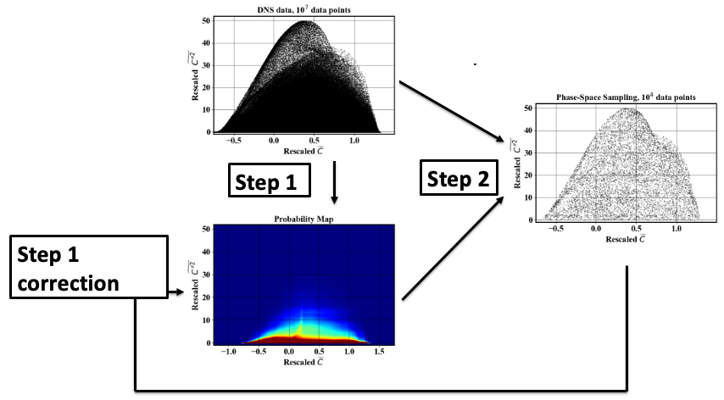
Uniform-in-phase-space data selection

Slide 2
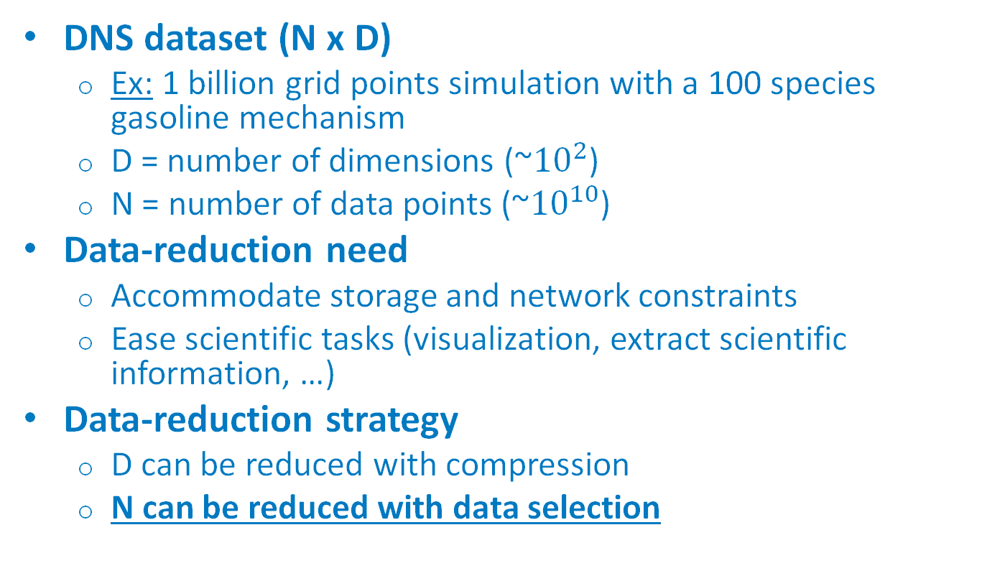
Motivation
DNS dataset (N x D)
Ex: 1 billion grid points simulation with a 100 species gasoline mechanism
D = number of dimensions (~${10}^{2}$)
N = number of data points (~${10}^{10}$)
Data-reduction need
Accommodate storage and network constraints
Ease scientific tasks (visualization, extract scientific information, …)
Data-reduction strategy
D can be reduced with compression
N can be reduced with data selection

Slide 3
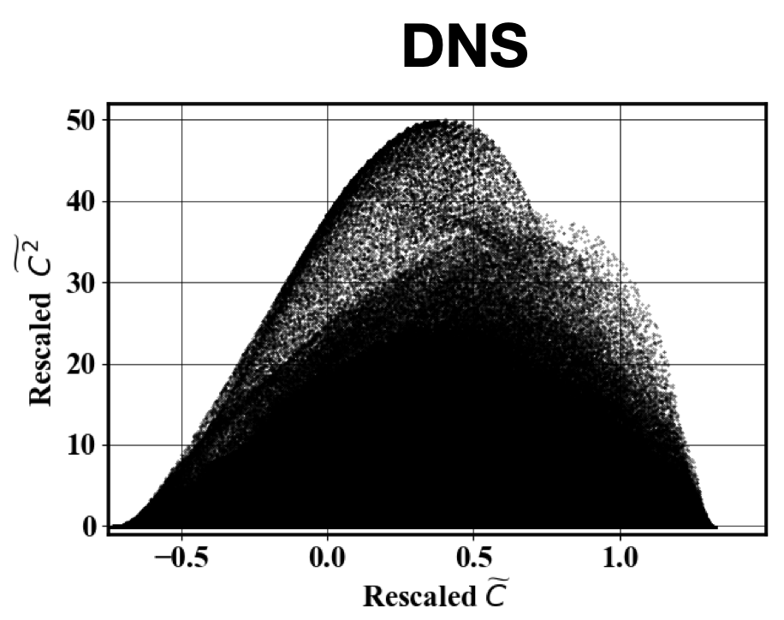
Uniform-in-phase space sampling
Objective:
Select n datapoints s. t.
n << N
n data points are uniformly distributed in phase-space
n data points cover the full phase-space
Why do that?
Ensure that rare data points are not discarded
Eliminate redundant data

Slide 4
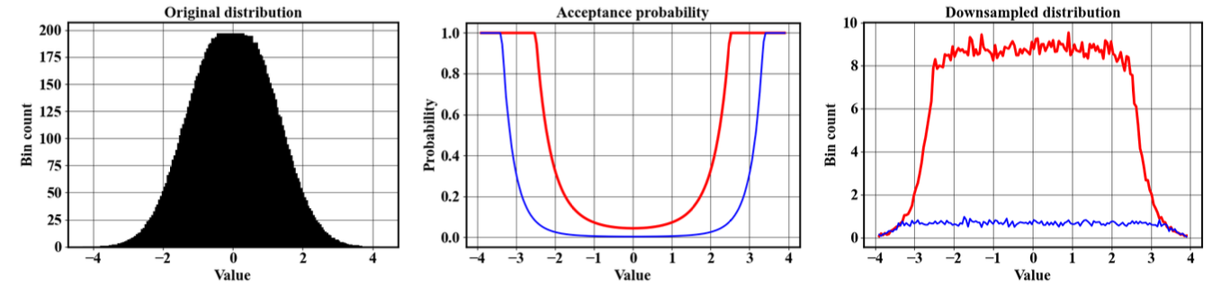

Strategy
Probability-based sampling
Accept each datapoint with an acceptance probability $s\left(x\right)=min⁡(\frac{c}{p\left(x\right)},1)$
Constant defined by n
Probability of observing x

Slide 5
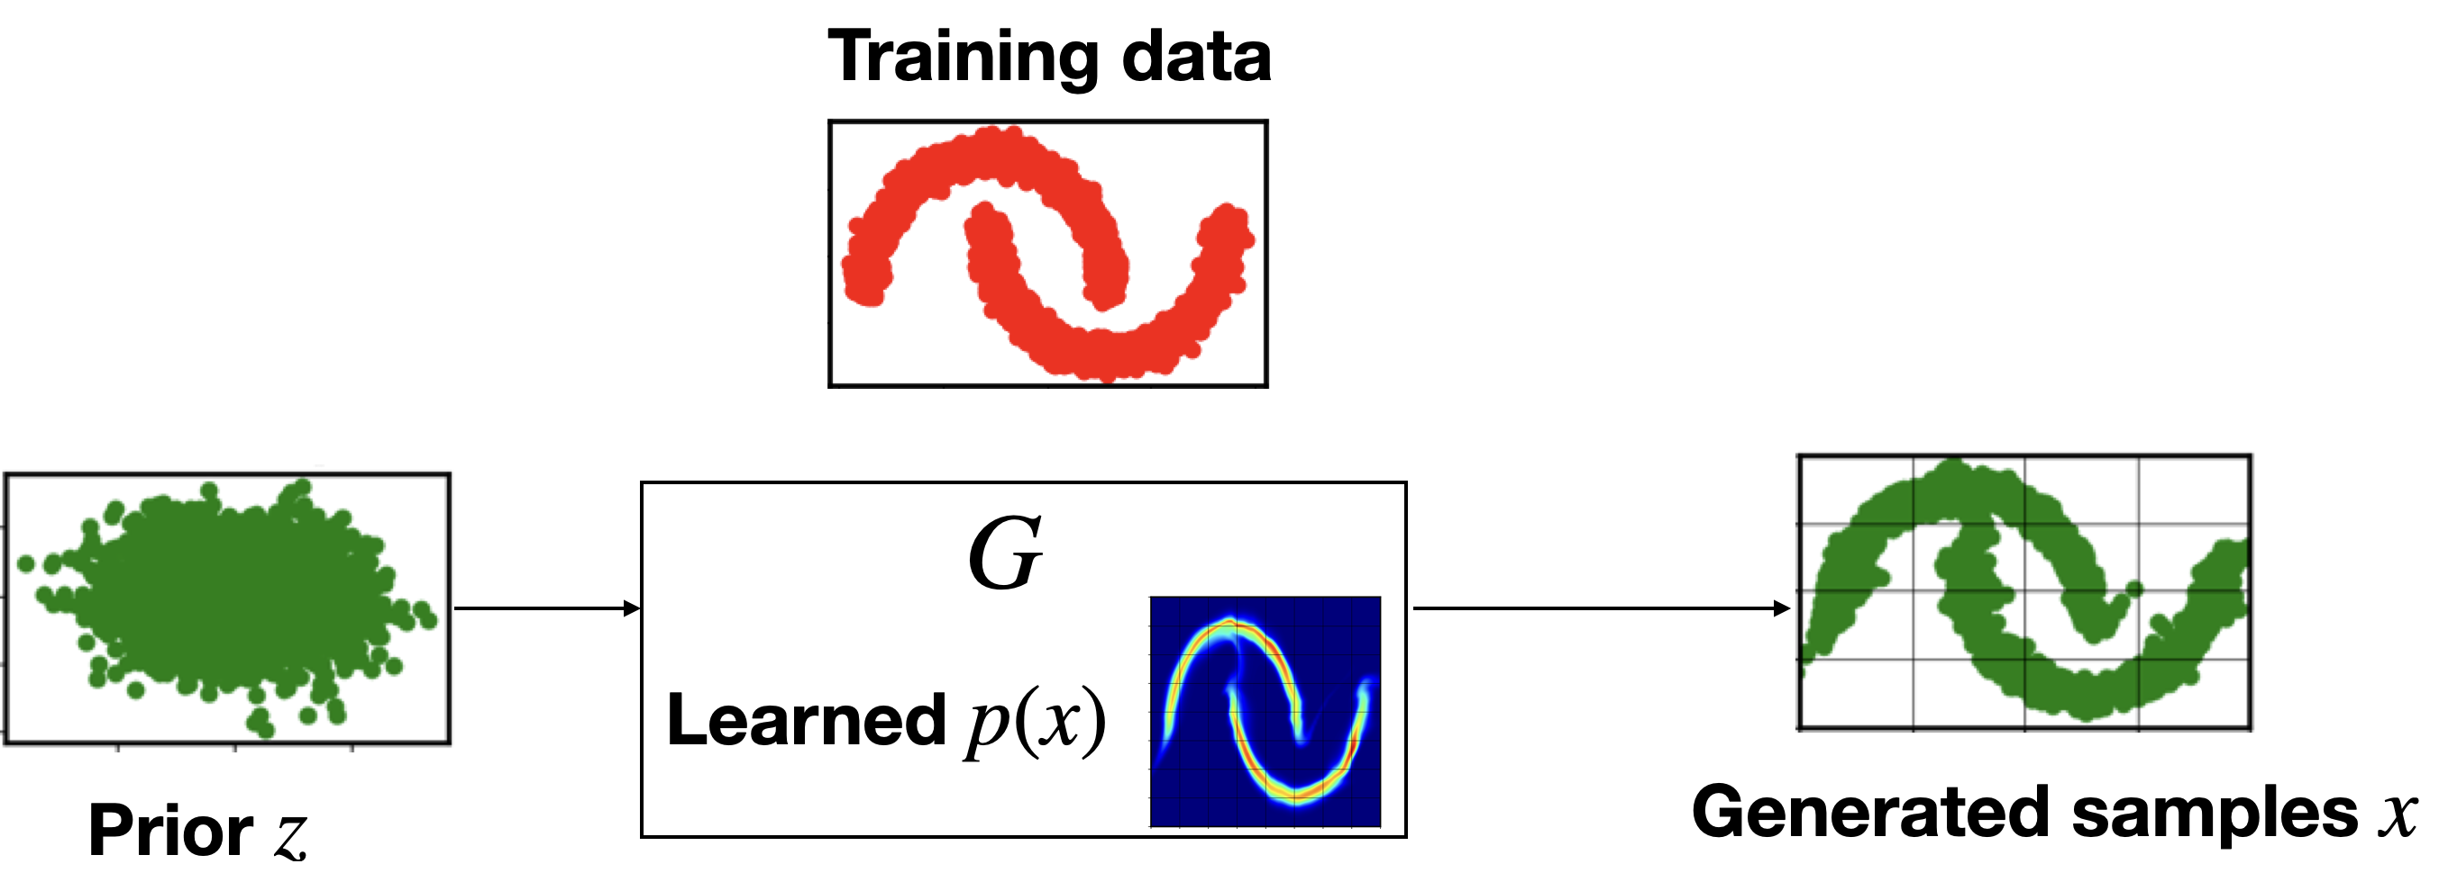
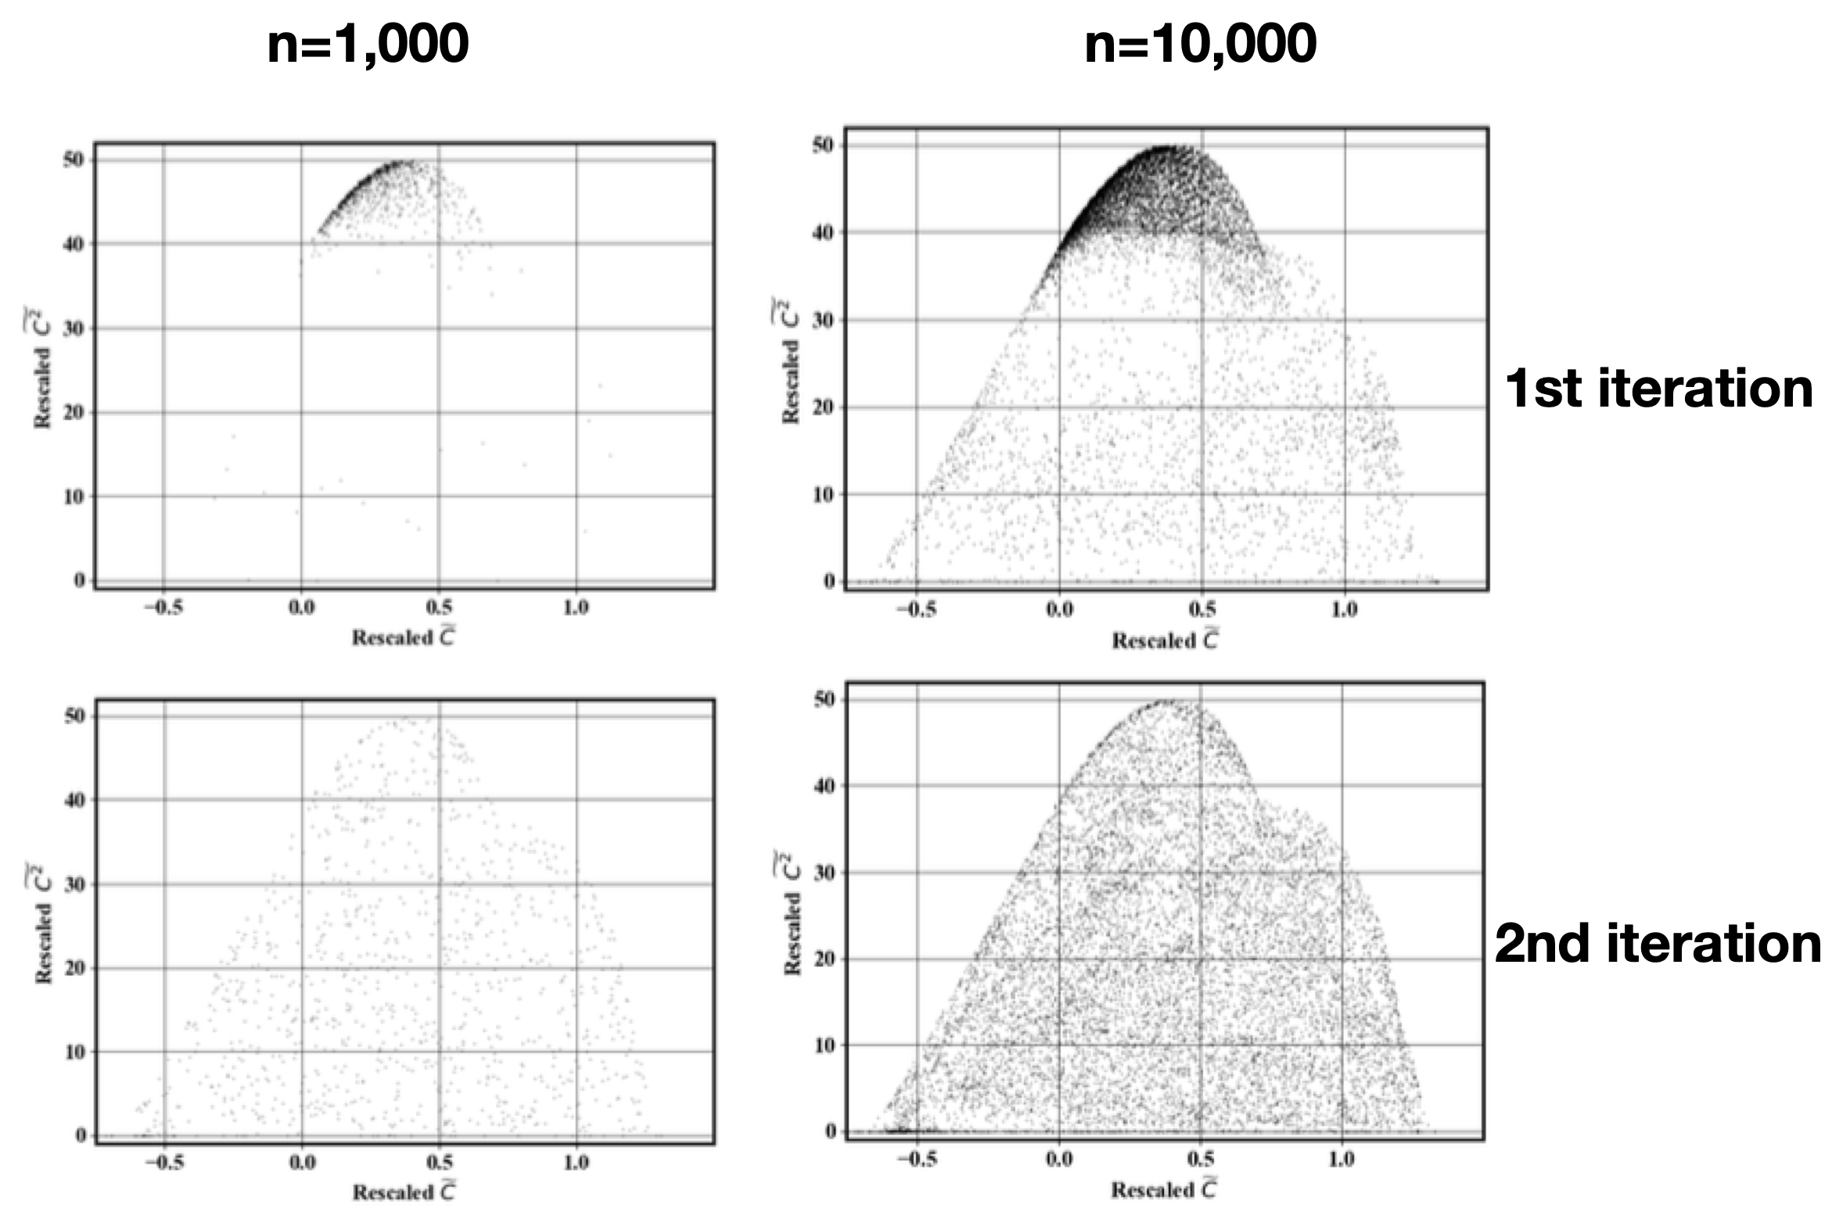
Estimation of p(x)
Accommodate large D
Use normalizing flow
Accommodate large N
Work with a subset of the data
Iterative procedure to correct p(x) estimate
Cost
Linear in N
Sublinear in D
Most expensive step is embarrassingly parallel
Density estimation GPU-accelerated

Slide 6
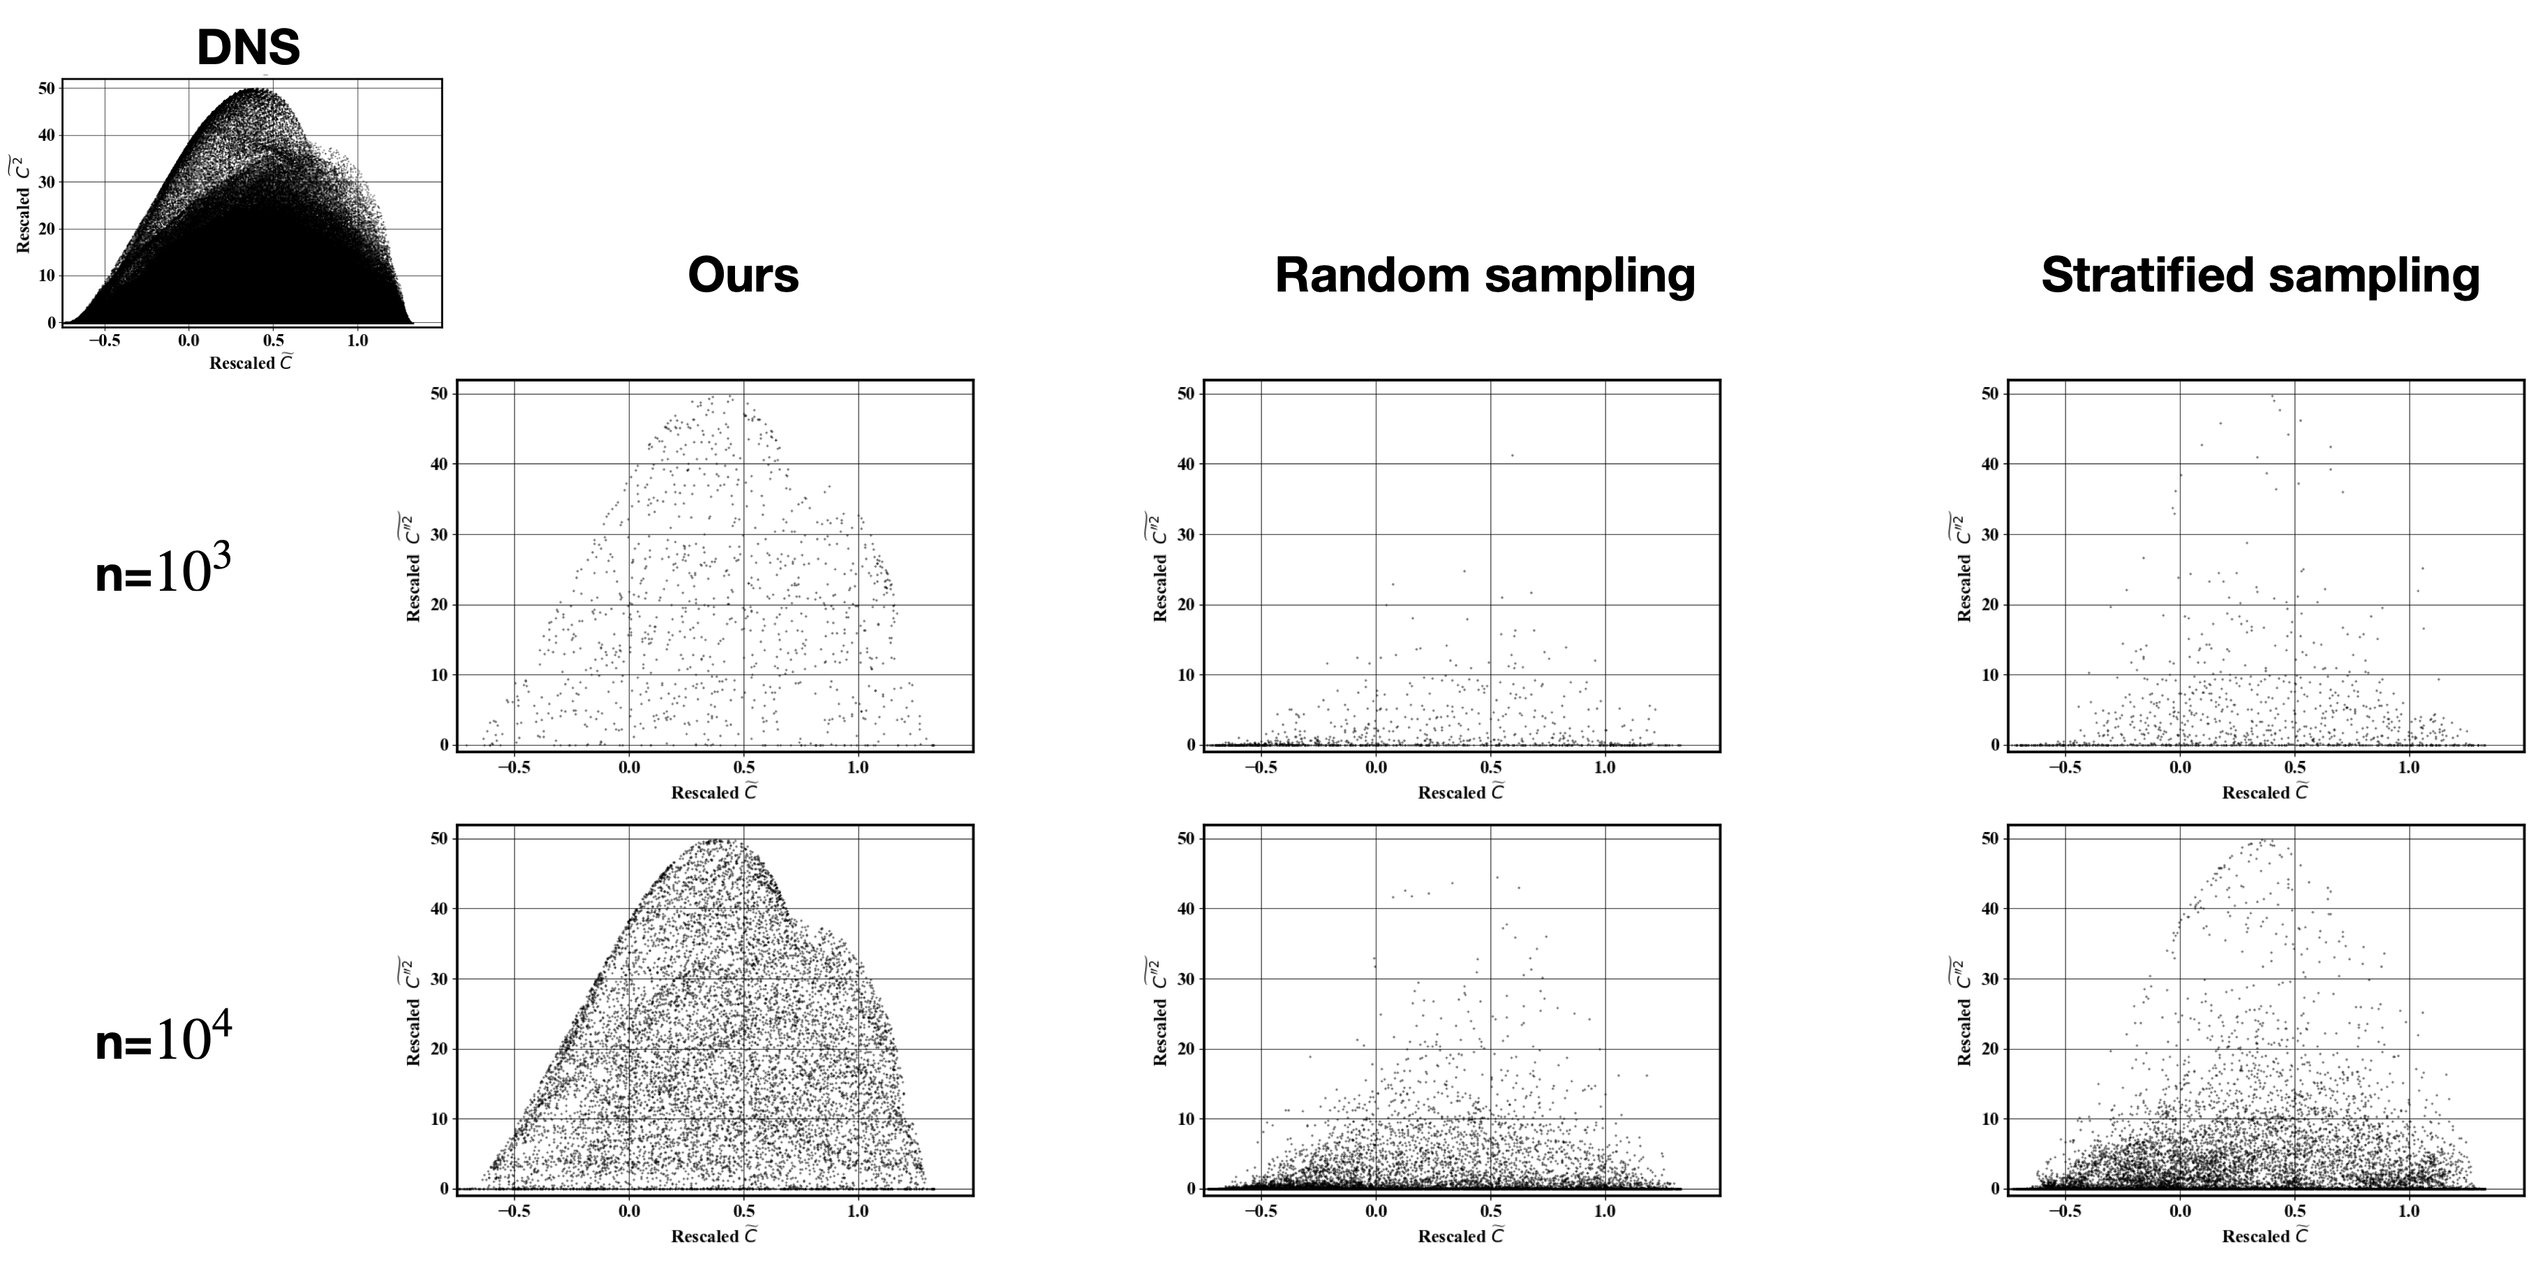
Comparison to typical strategies
Nguyen et al. 2021
Yellapantula et al. 2021

Slide 7
Conclusions
Computationally efficient data selection method
Efficient with high dimension (D) large number of datapoint (N)
Applicable to any dataset type
Code publicly available
https://github.com/NREL/Phase-space-sampling
Used by Princeton University, Sandia National Lab, National Renewable Energy Lab

Slide 8
Thank you
Funding:
PACE (DOE Vehicle Technologies Office)
Computational Resources:
Eagle HPC System (NREL)
This work was authored by the National Renewable Energy Laboratory, operated by Alliance for Sustainable Energy, LLC, for the U.S. Department of Energy (DOE) under Contract No. DE-AC36-08GO28308. Funding provided by the U.S. Department of Energy Office of Energy Efficiency and Renewable Energy Vehicle Technologies Office. The views expressed in the article do not necessarily represent the views of the DOE or the U.S. Government. The U.S. Government retains and the publisher, by accepting the article for publication, acknowledges that the U.S. Government retains a nonexclusive, paid-up, irrevocable, worldwide license to publish or reproduce the published form of this work, or allow others to do so, for U.S. Government purposes.

Slide 9
Additional slides

Slide 10
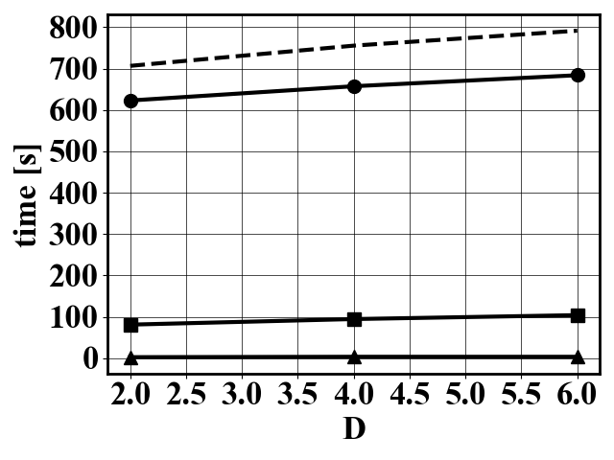
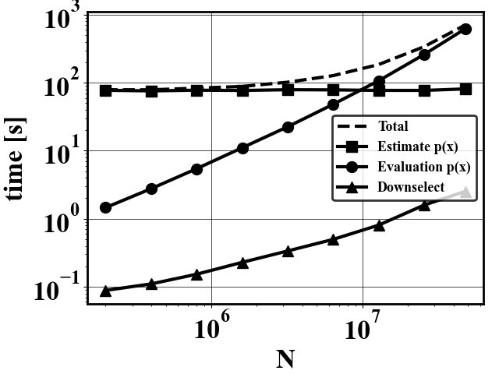
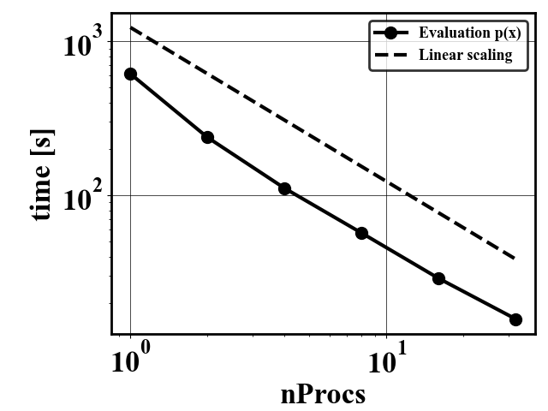
Computational cost data selection
Linear scaling with N
Sub linear scaling with D
Parallelization
MPI: Probability evaluation embarrassingly parallel
CUDA: Neural network training GPU-accelerated

Slide 11
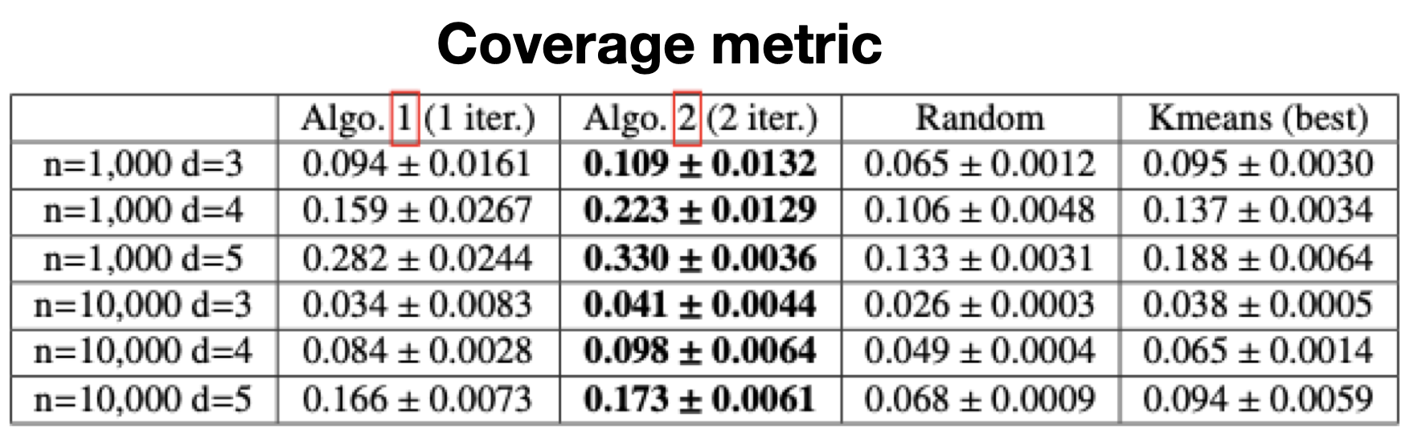
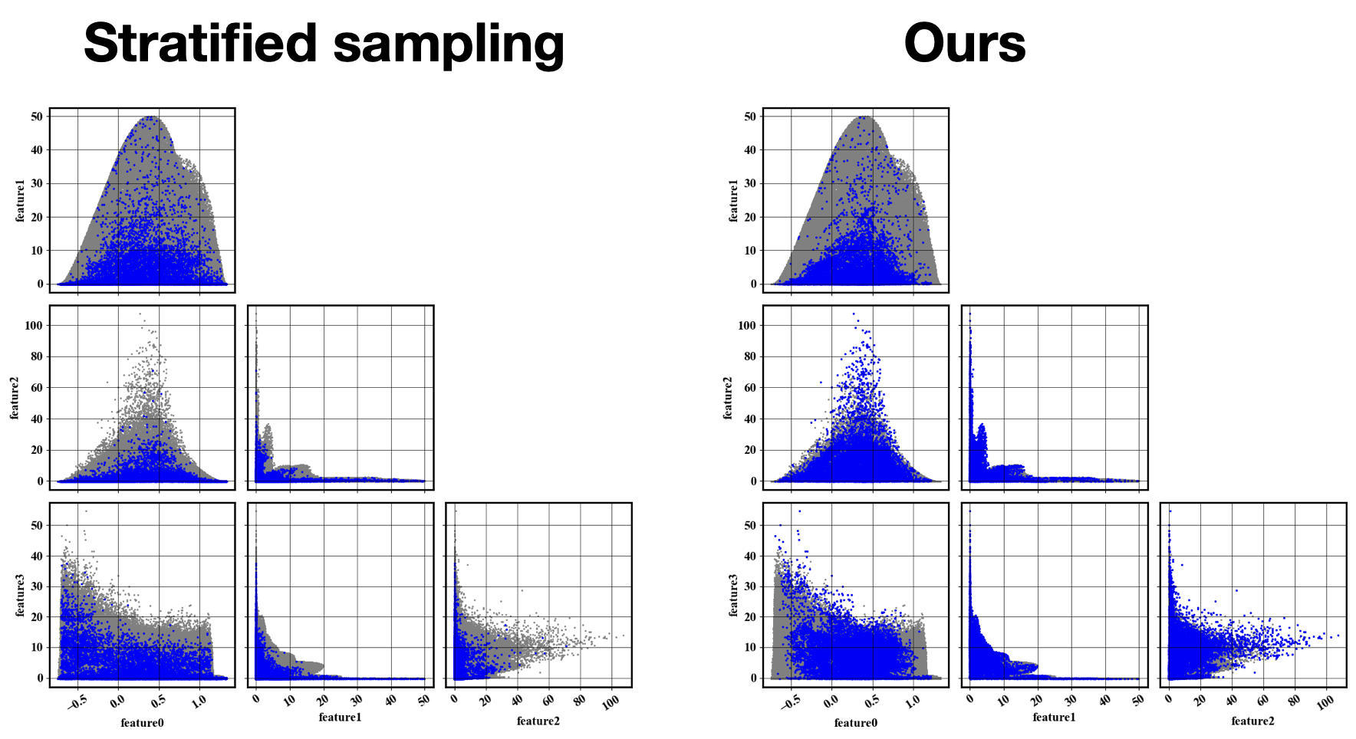
Performances in high dimension

Slide 12
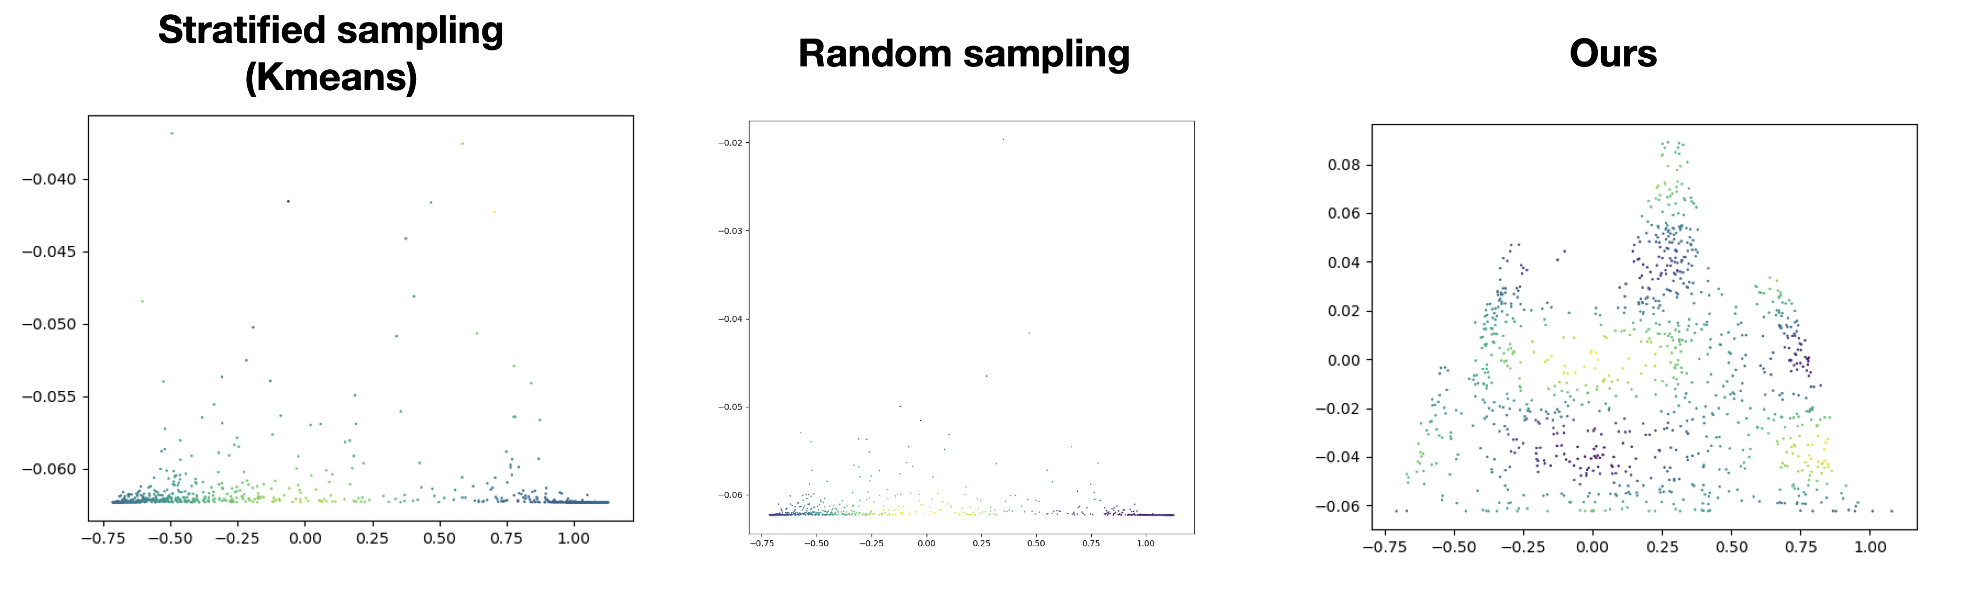
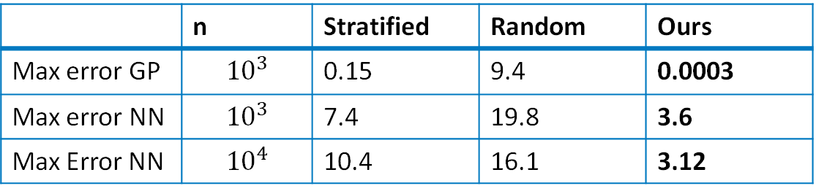
Data efficient Machine Learning
 | n | Stratified | Random | Ours
Max error GP | $${10}^{3}$$ | 0.15 | 9.4 | 0.0003
Max error NN | $${10}^{3}$$ | 7.4 | 19.8 | 3.6
Max Error NN | $${10}^{4}$$ | 10.4 | 16.1 | 3.12

